Slide 1
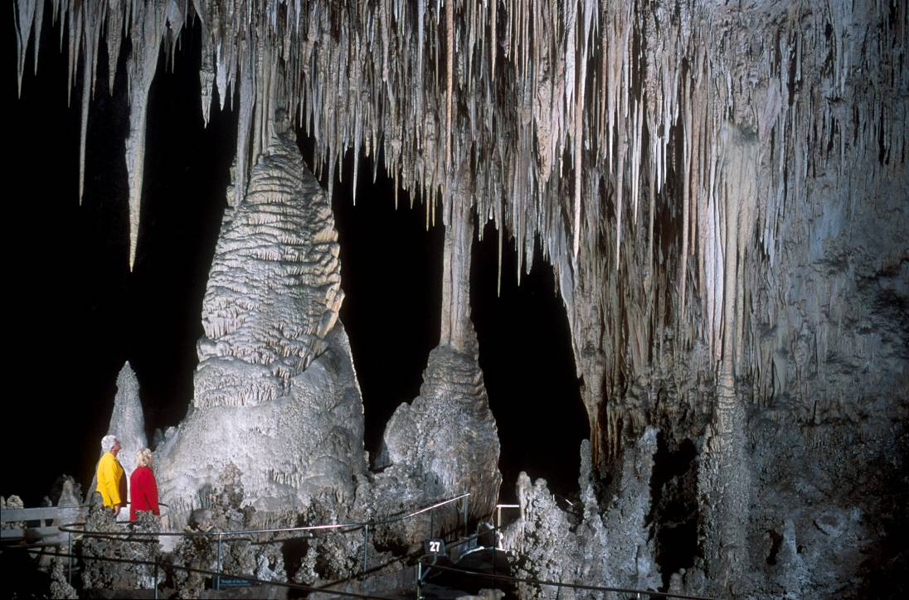
Notes:
Containing the largest single underground chamber the some of the largest speleothems in the world, Carlsbad Caverns is an undeniably special place. In this lesson we’ll see that this “World Heritage” site has a correspondingly special origin.

Slide 2
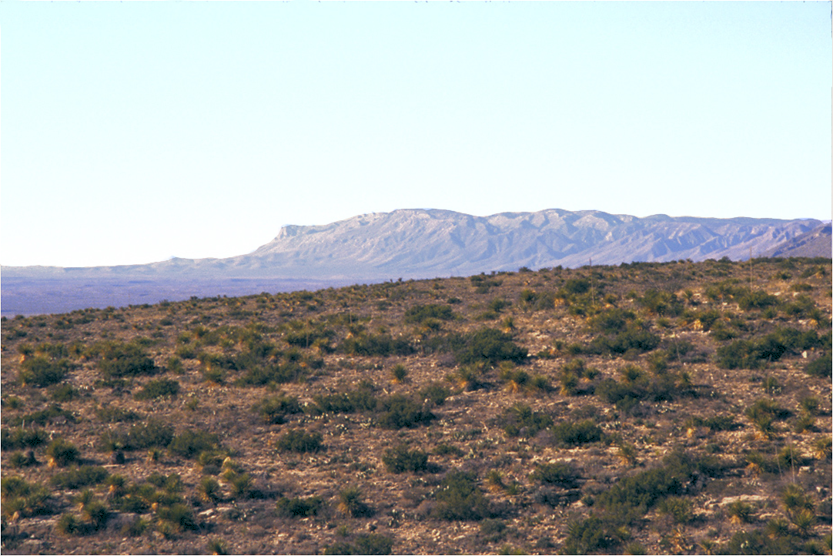
El Capitan
Notes:
The featureless landscape above Carlsbad Caverns gives little clue of the wondrous sights below, yet looking southwest, the view does offer a key link to its origin. Carlsbad Caverns was formed in the same ancient limestone reef as El Capitan.

Slide 3
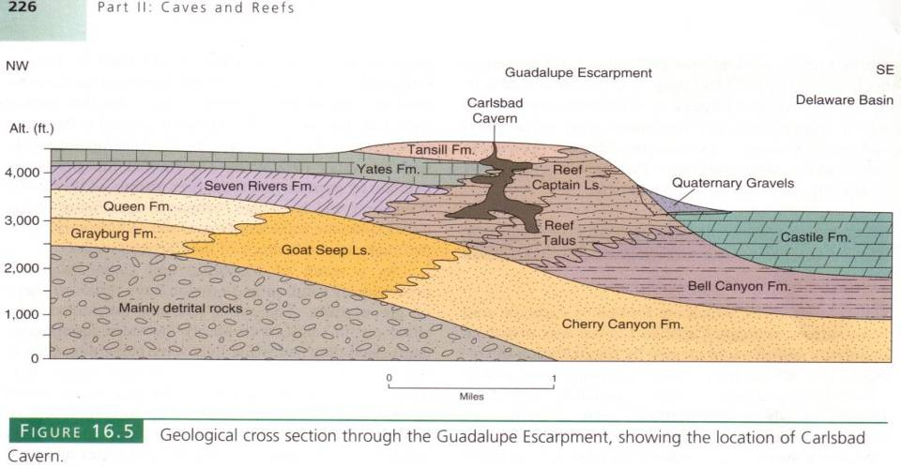
Notes:
The bulk of the cavern is formed within the massive reef facies of the Capitan Limestone, but some parts occupy the forereef talus facies and back reef Yates and Tansill Formations.

Slide 4
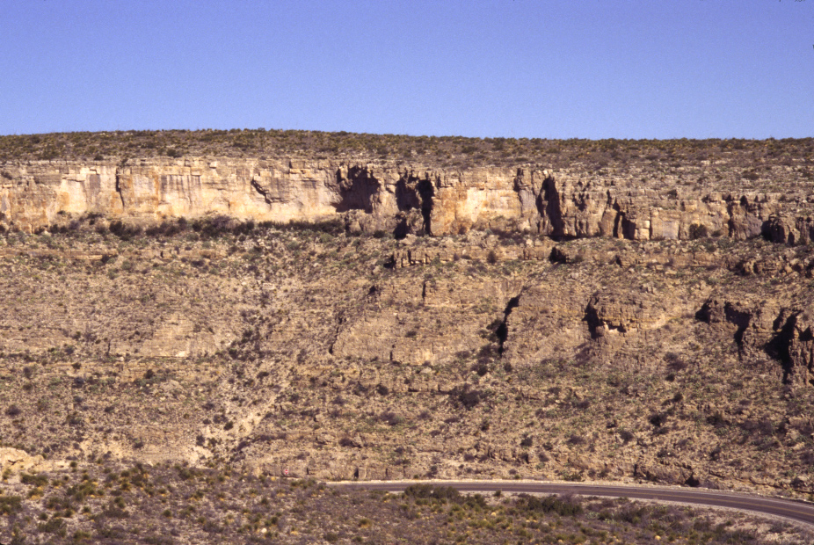
Tansill Fm.
Notes:
Near the entrance to Carlsbad Caverns you can see the bedded siltstone and limestone of the Tansill Formation.

Slide 5
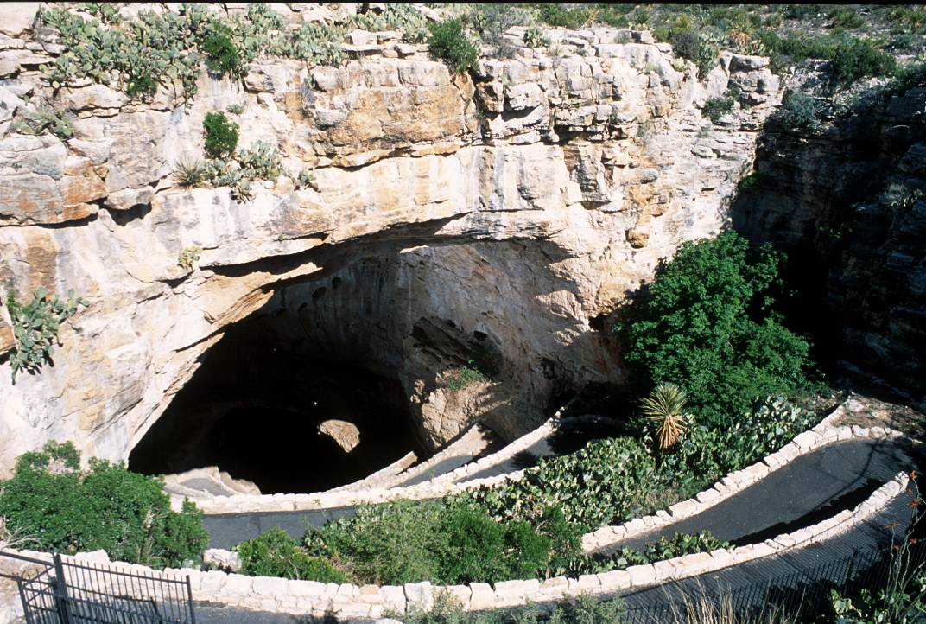
Notes:
The natural entrance to the cavern formed by the collapse of the cavern’s roof when the water table lowered and the buoyant force that helped support the roof was reduced. The bulk of the cavern formed while no connection to the surface existed.

Slide 6
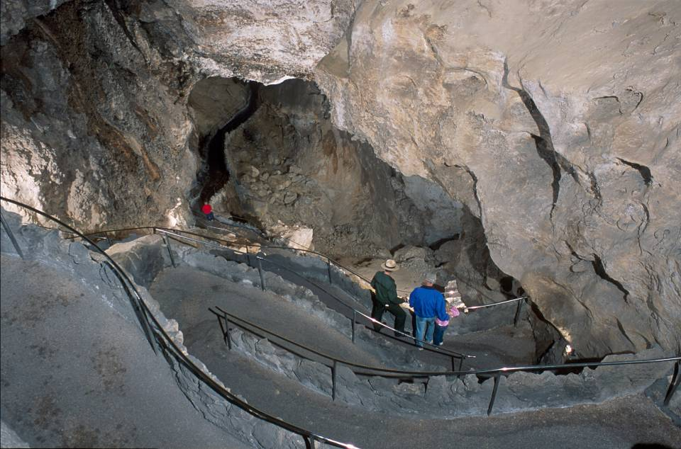
Notes:
Winding ones way down the main corridor entrance you can see many places where the roof has collapsed ….

Slide 7
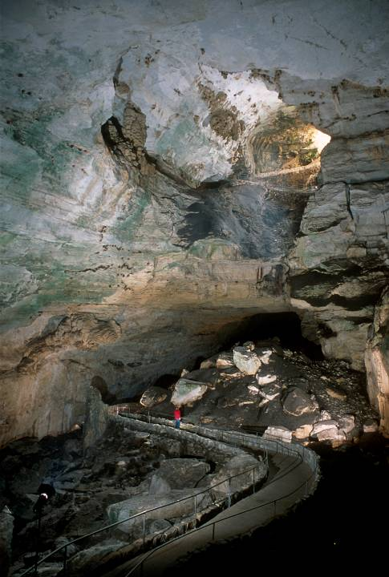
Debris from roof collapse
Notes:
… and left massive debris piles on the floor.

Slide 8
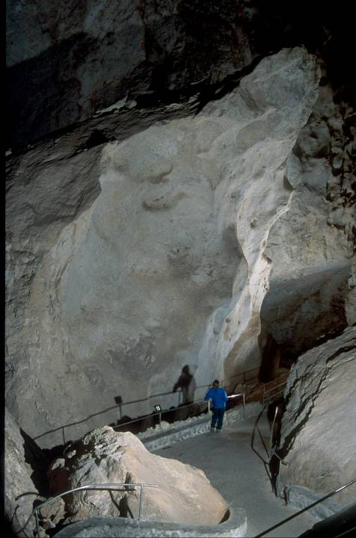
Iceberg Rock
Notes:
The largest single roof fragment is Iceberg Rock …

Slide 9
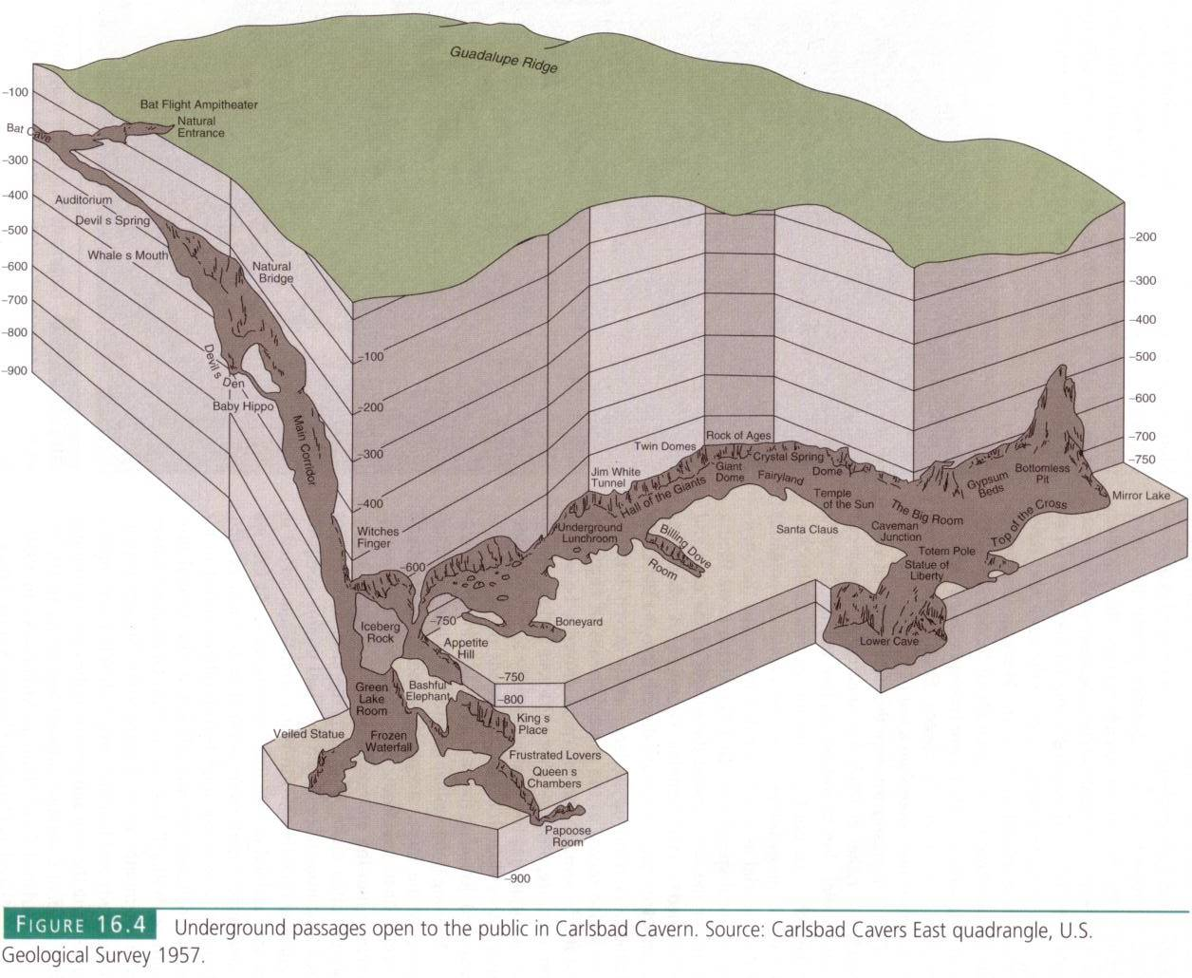
Notes:
… at the bottom of the Main Corridor some 600 feet below the surface. At that depth the cavern really opens up laterally as this was probably near the water table when the bulk of the cave was eroded.

Slide 10
RAIN
O₂
oldest caves
former water tables
limestone
water table
newest caves
groundwater
hydrogen sulfide
hydrogen sulfide
H₂S + 2O₂ = H₂SO₄
Hydrogen sulfide
Oxygen
Sulfuric Acid
Notes:
Although hotly debated since the idea was proposed back in the 1970’s, sulfuric acid is now widely accepted as the main dissolving agent which formed Carlsbad Caverns. The idea was met with much initial skepticism because the overwhelming majority of caverns in the world form by the action of carbonic acid.

Slide 11
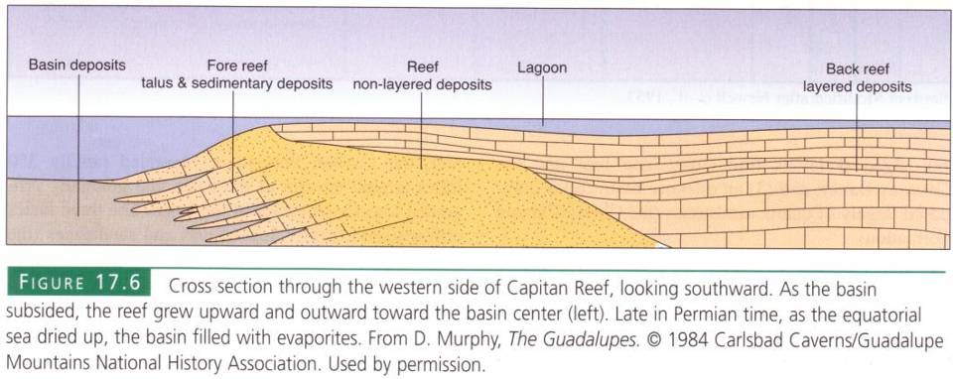
Notes:
The ultimate source for the hydrogen sulfide comes from the basin deposits.

Slide 12
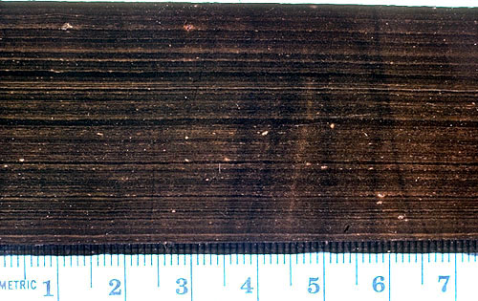
Notes:
Which as you will remember contain abundant organic matter …

Slide 13
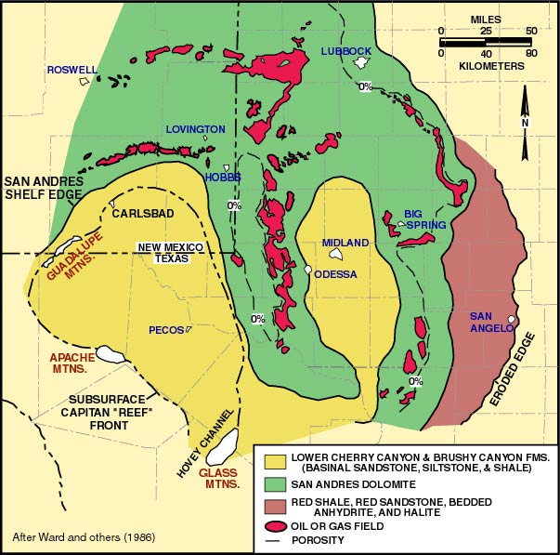
Notes:
… that later became the abundant oil deposits in the area. Hydrogen sulfide is a common gas emitted from oil fields.

Slide 14
RAIN
O₂
oldest caves
former water tables
limestone
water table
newest caves
groundwater
hydrogen sulfide
hydrogen sulfide
H₂S + 2O₂ = H₂SO₄
Hydrogen sulfide
Oxygen
Sulfuric Acid
Notes:
Hydrogen sulfide released from the oil fields became dissolved in the groundwater. Near the water table where oxygen is added to the groundwater via rain, the dissolved hydrogen sulfide oxidizes into sulfuric acid. Cavern formation was therefore most vigorous near the water table, so as the water table dropped, caverns formed at deeper levels.

Slide 15
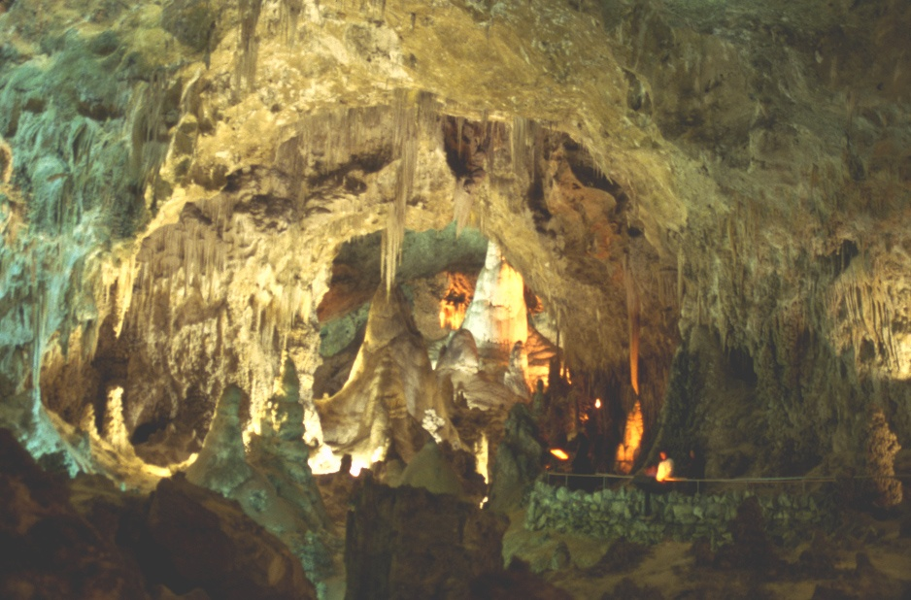
The “Big Room”
Notes:
The fact that sulfuric acid is far more aggressive in dissolving limestone than is carbonic acid accounts for the enormity of Carlsbad Caverns. The Big Room alone could comfortably fit some 14 football fields.

Slide 16
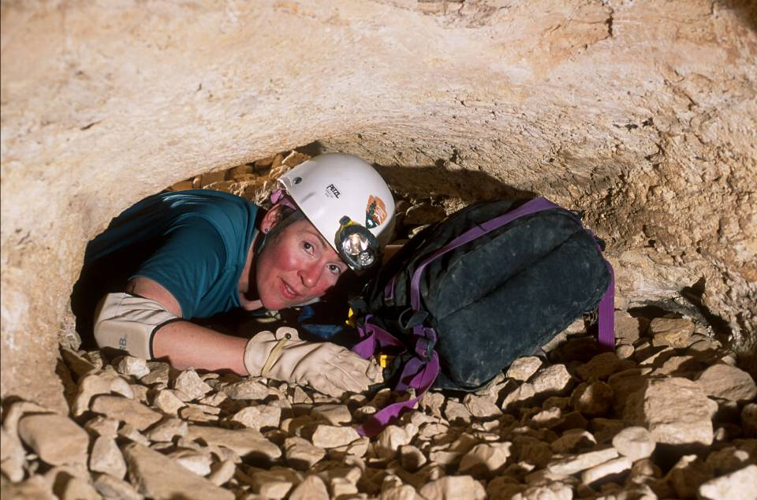
Spider Crawl Tour
Notes:
Although Carlsbad is famous for its giant caverns, the aggressive action of sulfuric acid within original pores in the limestone has in places has made a Swiss Cheese-like network of much smaller, chaotic passageways. Such aptly named “spongework” can be seen on the Spider Crawl tour, …

Slide 17
Spider Crawl Tour
I love to sleep between my mattresses.
Notes:
… which is available by special arrangement for those who might be called claustrophiliacs.

Slide 18
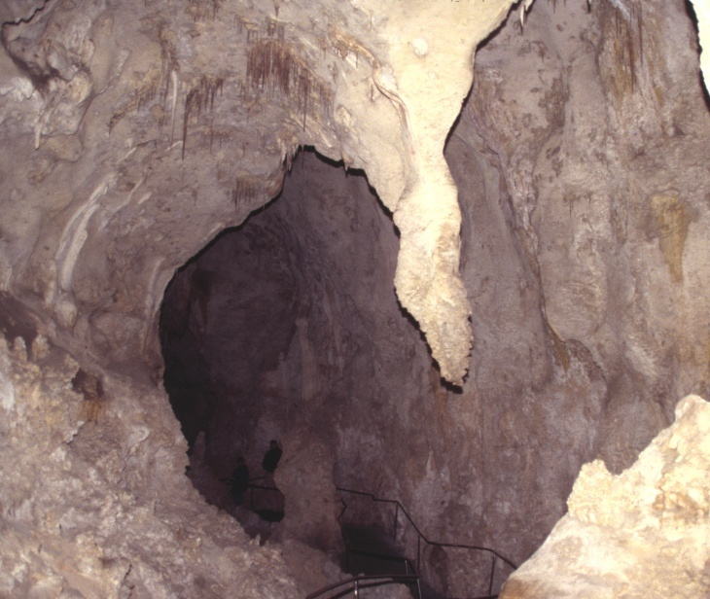
Notes:
Spongework aside, most solution took place along vertical fractures, so many of the caverns are taller than they are wide.

Slide 19
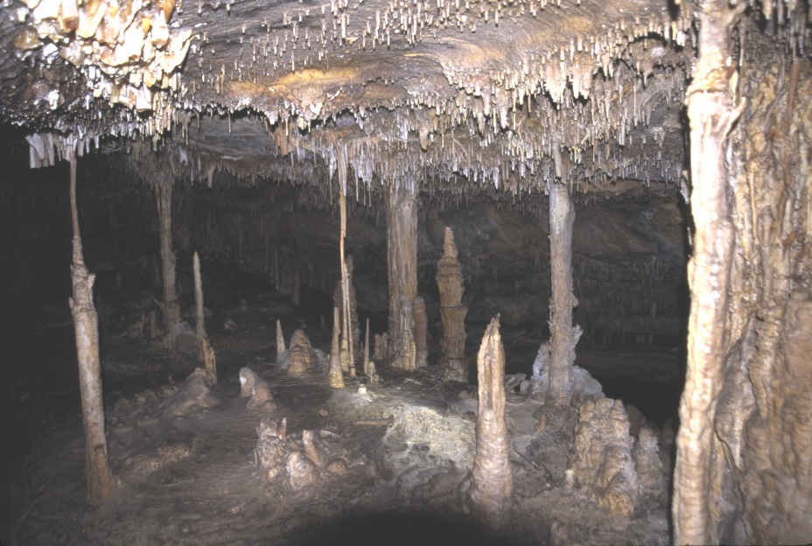
Lehman was formed by Carbonic Acid
carbonic acid
Notes:
Such is not the case for caves carved by carbonic acid, which is really only strong enough to dissolve limestone right at the water table were fresh carbonic acid is added from the surface. The constant addition of acidic surface water results in a relatively high rate of groundwater flow through carbonic acid-carved caverns, so most insoluble residues are swept away, leaving the floor mostly free of such debris.

Slide 20
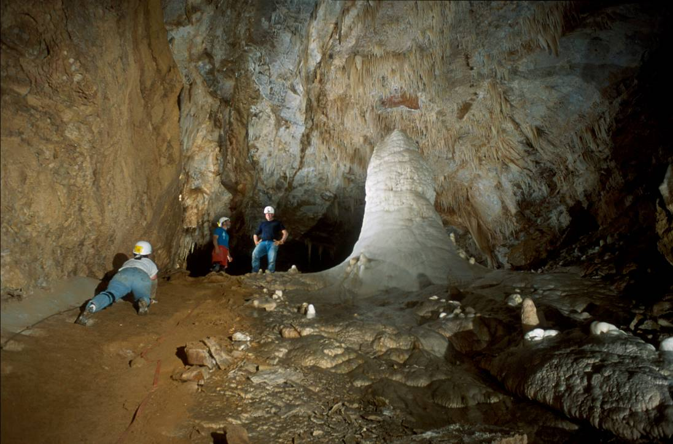
Notes:
In contrast, the deeper reaches of Carlsbad Caverns have a great deal of insoluble muck on the floor.

Slide 21
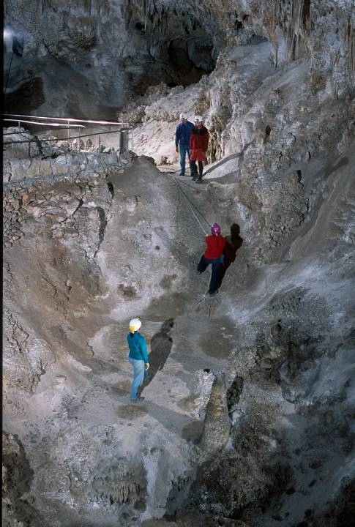
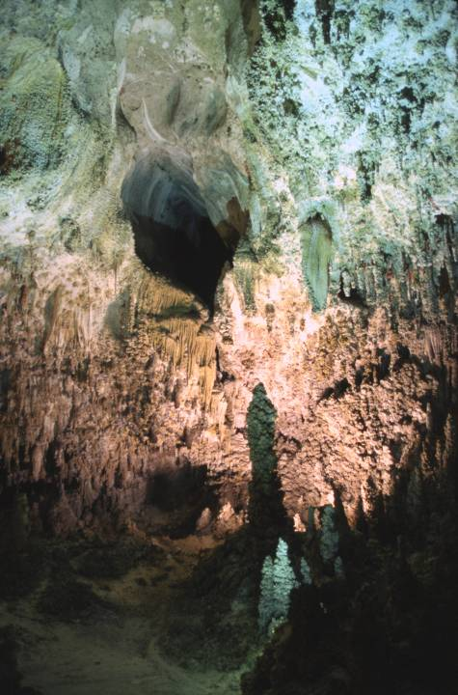
Notes:
Relatively stagnant groundwater also promoted the formation of far more irregular caverns at Carlsbad.

Slide 22
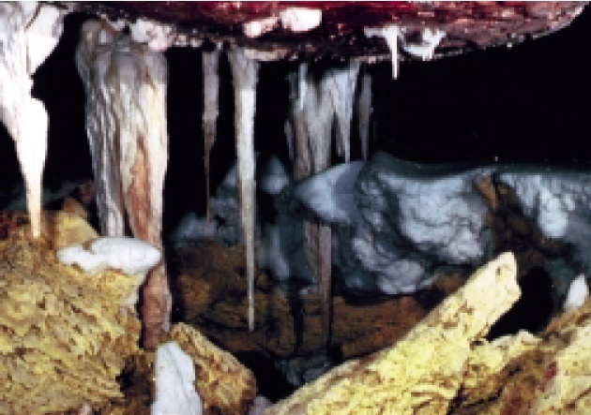
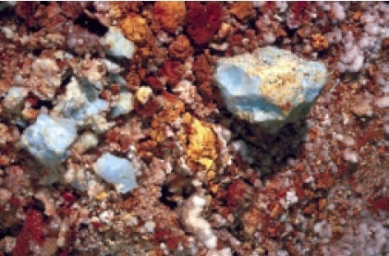
Endellite
Sulfur
Notes:
Additional evidence for the work of sulfuric acid at Carlsbad comes from the presence of endellite which forms from the alteration of clay minerals in an acidic, sulfur-rich environment; and pure sulfur deposits in some parts of the cave.

Slide 23
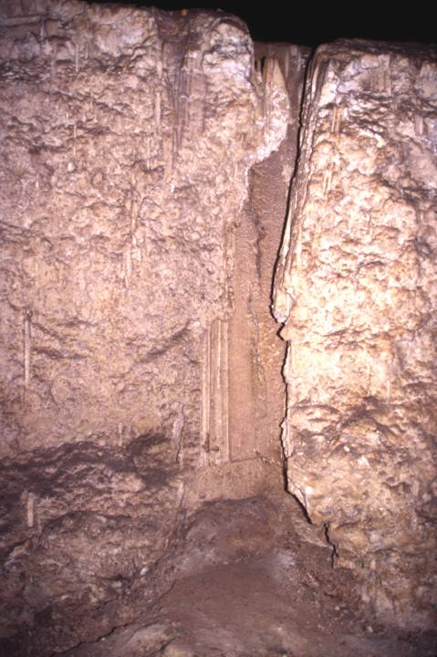
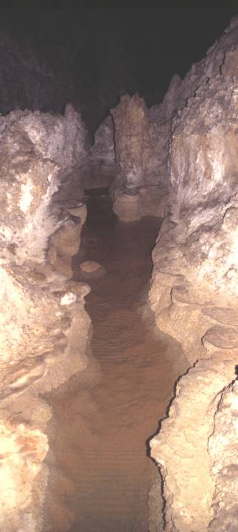
Thick gypsum on floor
Notes:
But the big smoking gun here is the thick layer of gypsum found on the floor of the largest caverns.

Slide 24
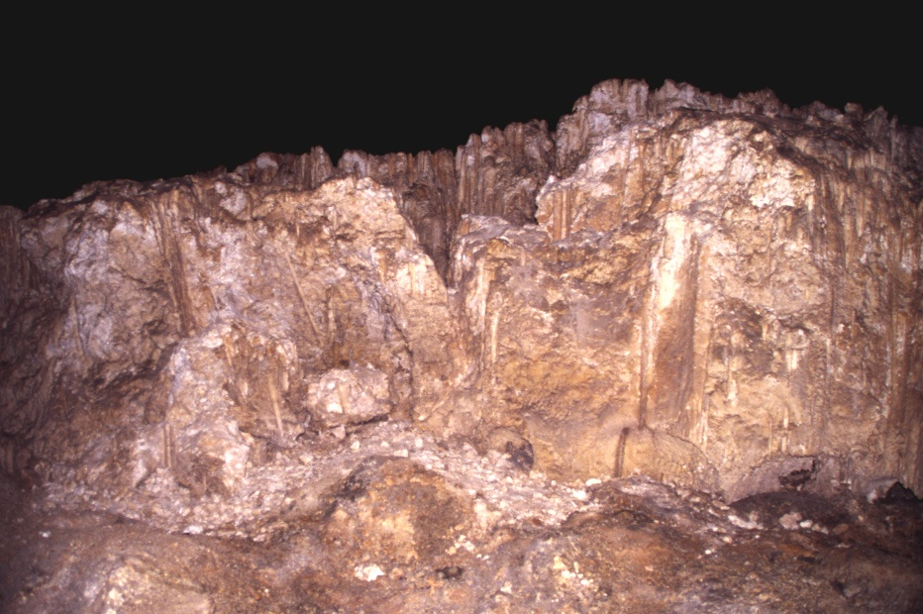
GYPSUM (CaSO₄.2H₂0)
Notes:
Gypsum is calcium sulfate. A sample of gypsum block collected from the Big Room, contained isotopically light sulfur that could not have come from the Castile Formation, but indicates biological activity as would be the case if the sulfur came from oil-derived hydrogen sulfide.

Slide 25
former water tables
water table
Limestone (CaCO₃)
gypsum
Groundwater (H₂O + H₂SO₄)
H₂SO₄ + CaCO₃ + 2H₂O = (CaSO₄ . 2H₂O) + H₂O
Sulfuric Acid
Calcium carbonate
water
gypsum
water
Notes:
The chemistry here is pretty straight forward. The same thing happens if you drop a common sea shell (CaCO₃) in battery acid (H₂SO₄). Calcium carbonate, the same compound in “Tums”, neutralizes the acid, leaving water and a residue of gypsum. Gypsum is more common at lower levels because the higher, older deposits are dissolved and re-precipitated at lower levels…

Slide 26
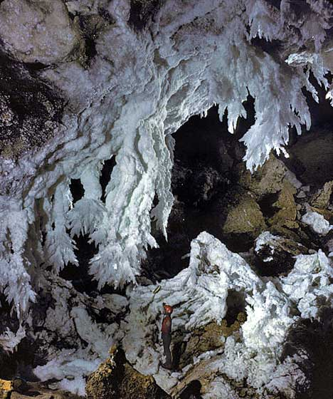
Notes:
… sometimes as spectacular gypsum stalactites. Note person for scale.

Slide 27
Ornamentation:
1. Flat terrain = thick soil 2. Ample carbonic acid 3. Deep caverns 4. = mega speleothems
Notes:
Like the caverns themselves, Carlsbad’s speleothems are extraordinarily large. That’s because the flat terrain above promoted infiltration of rainwater rather than runoff, so relatively deep soils developed in which the decomposition of organic matter produced ample carbon dioxide and carbonic acid. Huge amounts of limestone were dissolved and re-precipitated because the great depth of the caverns required the carbonic acid-rich surface waters to come in contact with a lot of limestone on their way down.

Slide 28
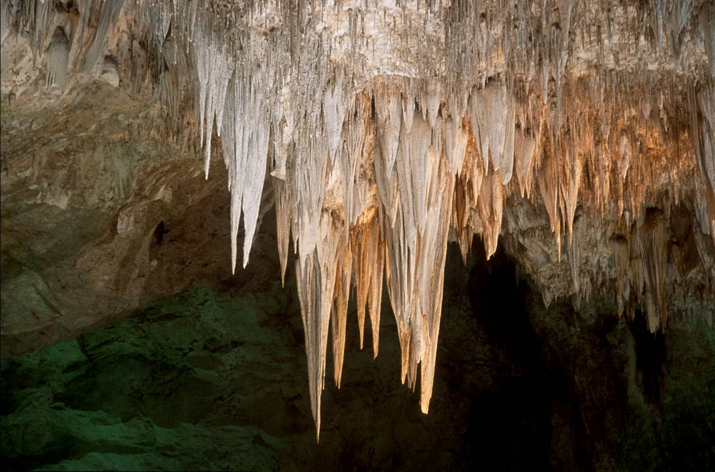
“The Chandelier” (Dripstone)
Notes:
Speleothems are classified as to their origin. Dripstone forms from lime-saturated groundwater dripping off the ceilings of the cave. Stalactites like this formation known as “The Chandelier” and …

Slide 29
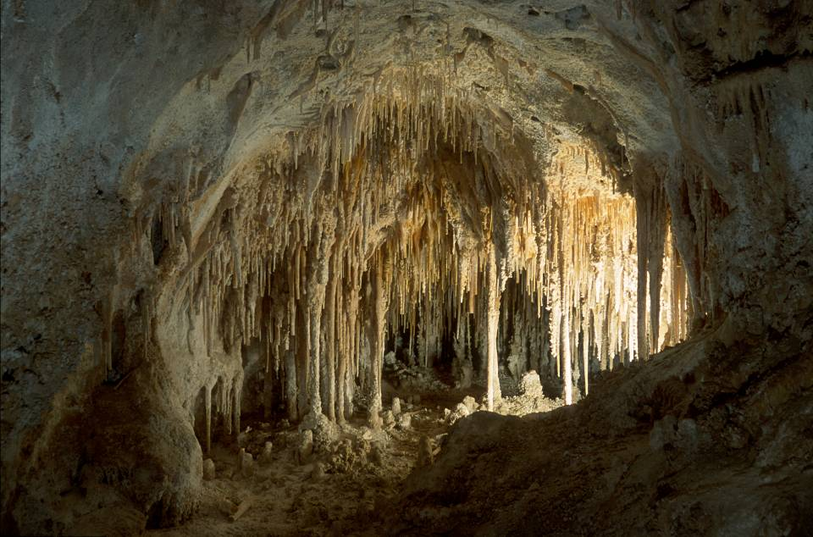
Dolls Theater (Dripstone)
Notes:
… those that make up the “Dolls Theater” are dripstone, …

Slide 30
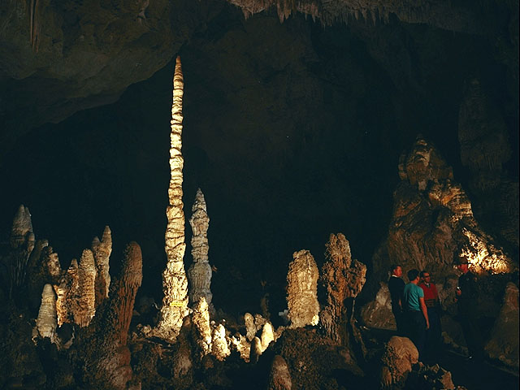
Stalagmites (Dripstone)
Notes:
… as are stalagmites ….

Slide 31
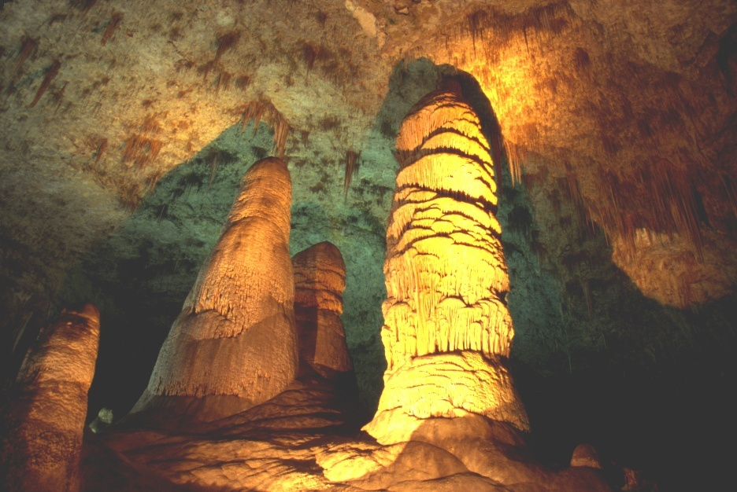
Hall of Giants (Dripstone)
Notes:
… like the monumental ones in the Hall of Giants.

Slide 32
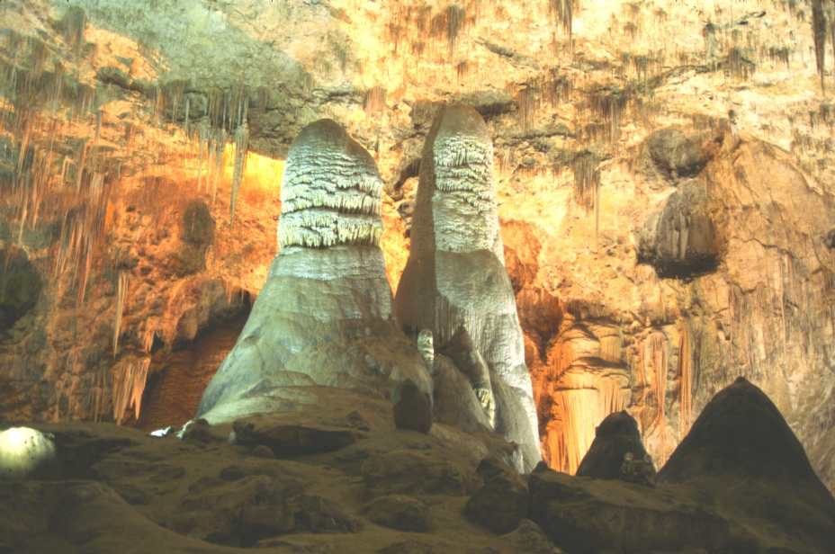
Hall of Giants (Dripstone)
people
Notes:
The Hall of Giants contains some of the largest stalagmites in the world. Note the people for scale.

Slide 33
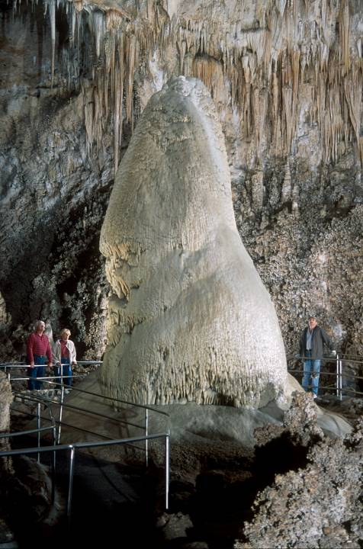
Crystal Spring Dome
Notes:
Variations in the flow rate and amount of dissolved carbonate affect the speleothem’s ultimate form. Dome-like forms …

Slide 34
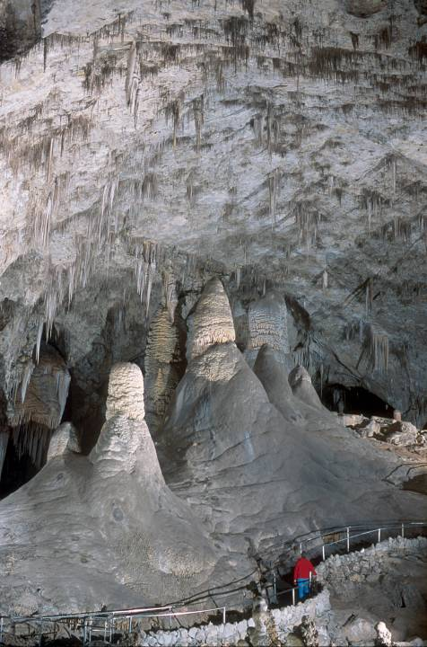
Notes:
… imply a high flow rate of carbonate-rich water from above, …

Slide 35
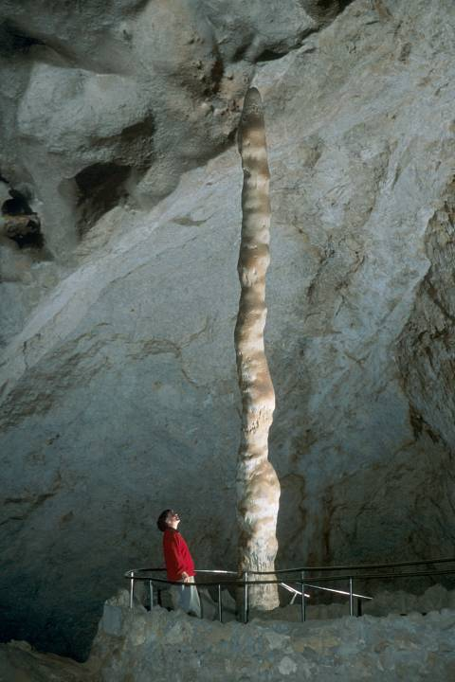
Witch’s Finger
Notes:
… whereas long, narrow stalagmites indicate that the solutions were supplied more slowly, but constantly.

Slide 36
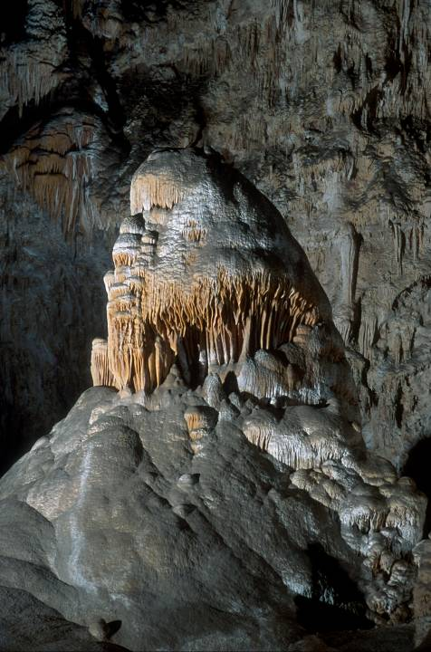
“The Caveman”
Notes:
Stalagmites often take statue-like forms for which our imagination finds likenesses.

Slide 37
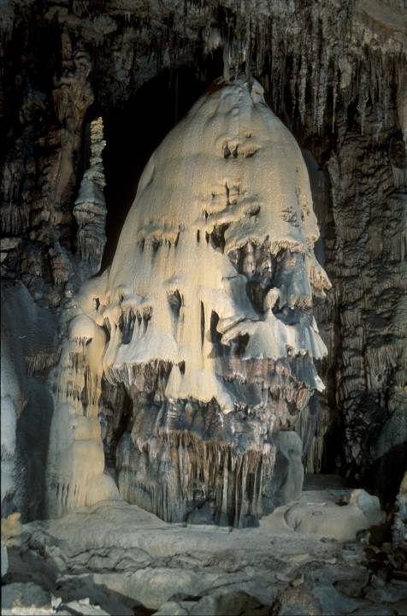
Christmas Tree
Notes:
Some are delightful, …

Slide 38
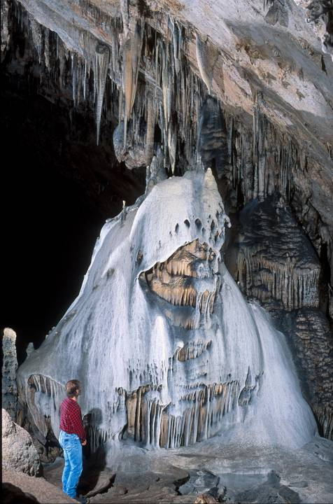
The Guardian (Klansman)
Notes:
… others border on the macabre. This formation was once known as “The Klansman” but that’s been replaced by the more PC title – “The Guardian”. Can you imagine the willies the pioneering spelunkers got when they first shone light on this thing!

Slide 39
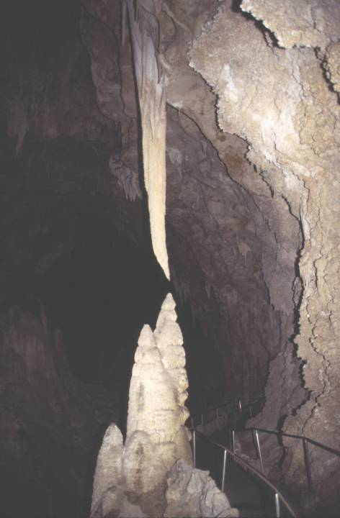
Notes:
Once stalactites and stalagmites join into …

Slide 40
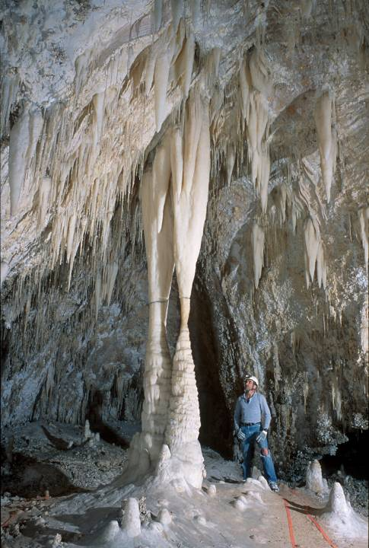
Columns are flowstone.
Notes:
… columns, dripping water no longer plays a role in their formation. Columns are therefore classified as flowstone.

Slide 41
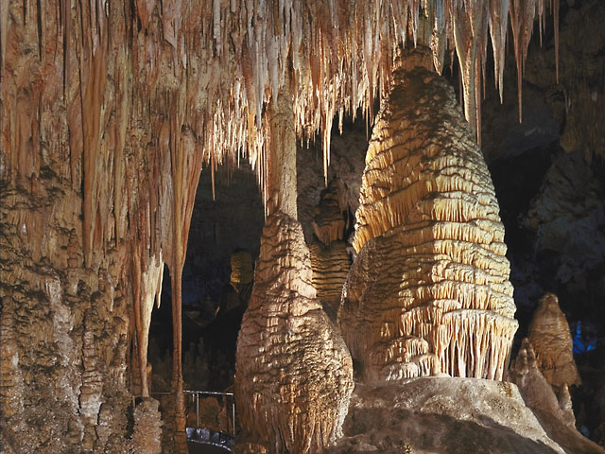
Notes:
The intricate tiers on these columns formed when they where still stalagmites (and therefore dripstone) by drip splash. Flowstone would eventually cover these formations if they were still active.

Slide 42
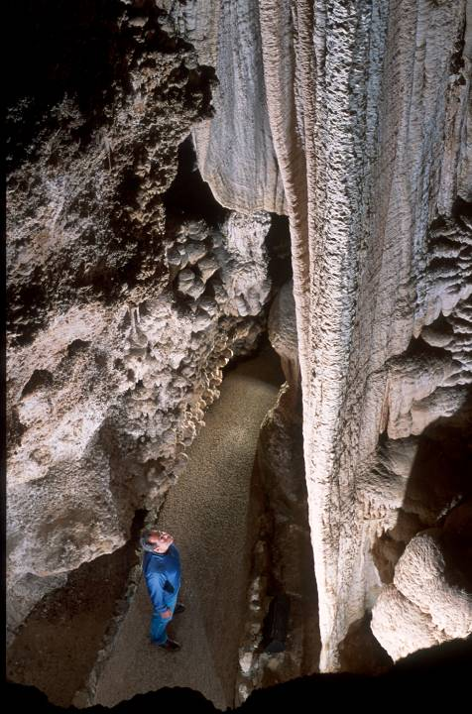
Draperies are flowstone.
Notes:
Draperies form when water flows across …

Slide 43
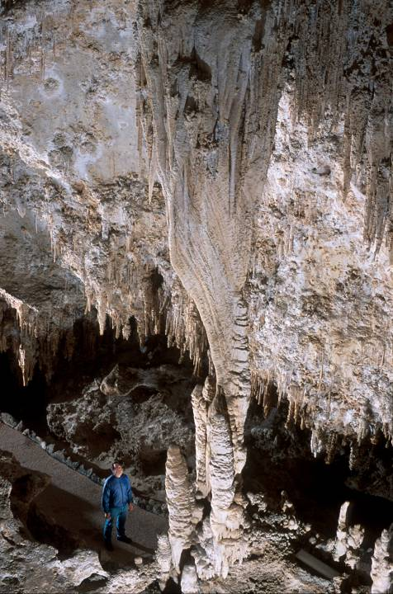
Notes:
… sloping cave ceilings.

Slide 44
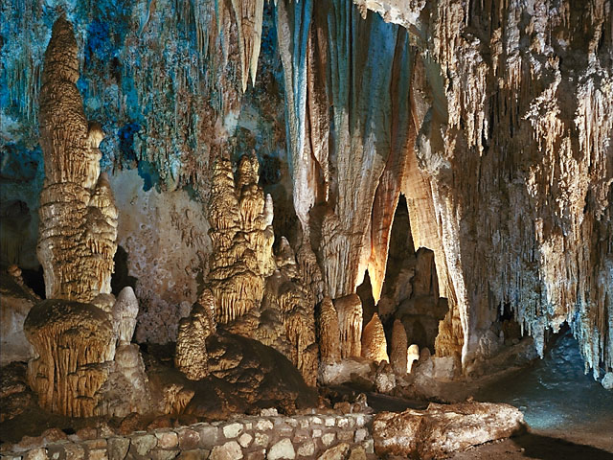
Notes:
Draperies are perhaps the most aesthetically pleasing flowstones, …

Slide 45
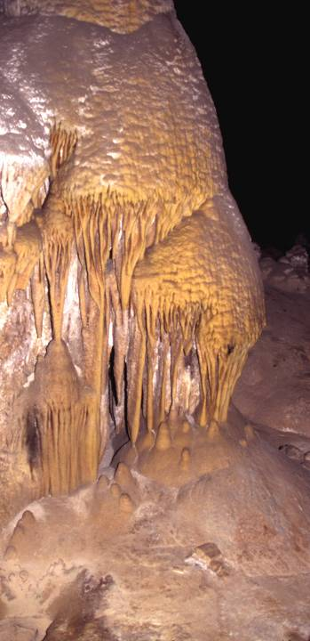
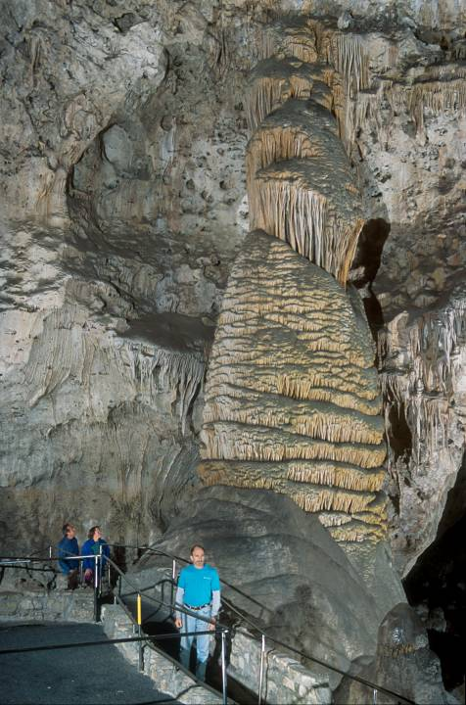
Flowstone
Notes:
… but the largest occur on the walls and floors of the cave.

Slide 46
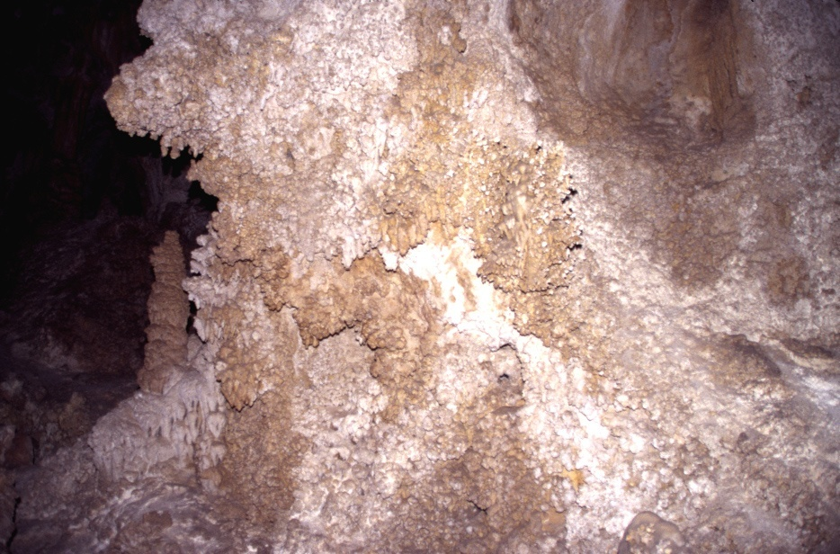
popcorn
Notes:
One of the most common speleothems is popcorn. Neither flowstone nor dripstone, popcorn instead forms where air flows across saturated surfaces, resulting in evaporation and precipitation of carbonate. Capillary action keeps replacing the evaporated water so the formations can become quite thick.

Slide 47
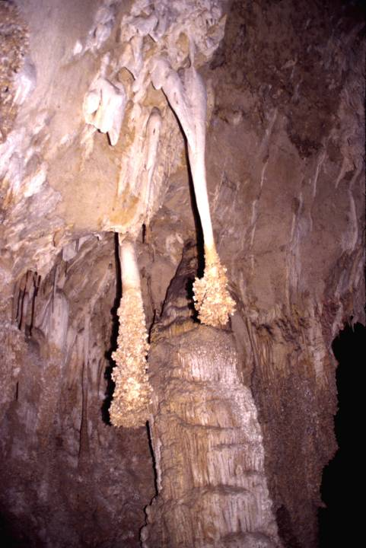
“Lions Tail”
air flow
Notes:
That evaporation was involved in the formation of popcorn is evidenced by the accumulation of thicker popcorn on the windward side of formations.

Slide 48
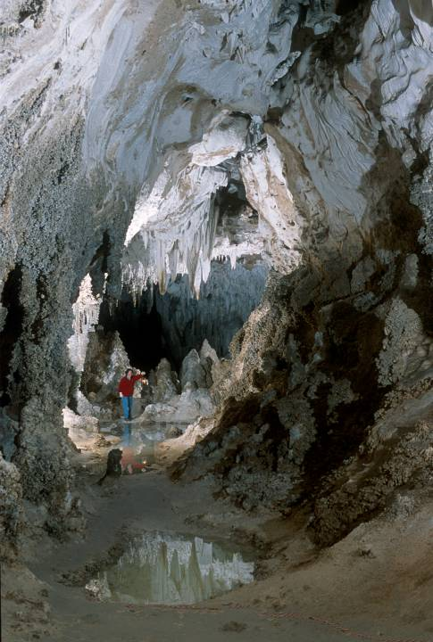
Notes:
Right at the water table…

Slide 49
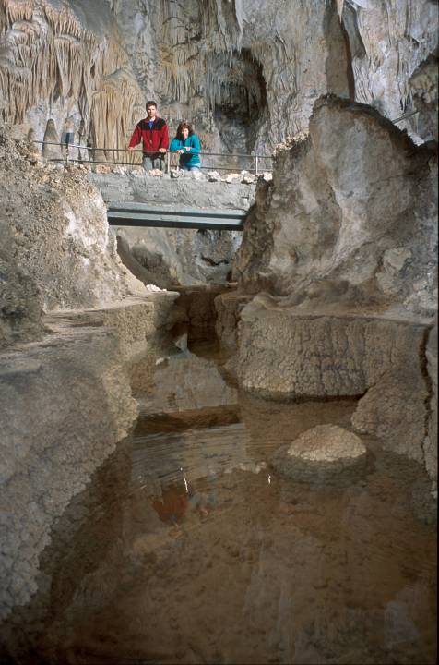
rimstone
Notes:
… shelf-like rimstone forms because that’s where carbon dioxide comes out of solution. You can tell that the water table was once higher here.

Slide 50
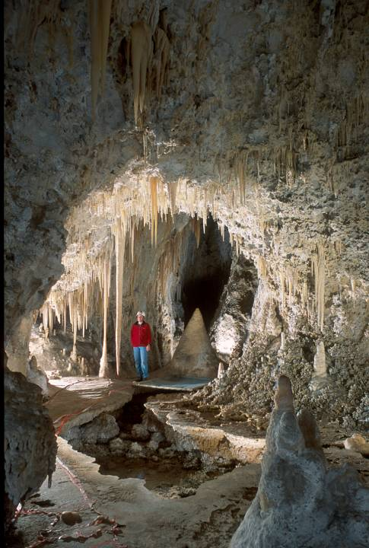
Notes:
Rimstone adds a pleasing horizontal counterpoint to the verticalness of most speleothems.

Slide 51
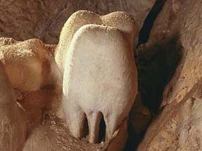
“Bashful Elephant”
Notes:
There are many, many other kinds of formations at Carlsbad, but the “Bashful Elephant” says it’s time to go now, so we’ll leave the rest for you to see in person.

Slide 52
Notes:
Carlsbad Caverns 24 DBH Bat guano

Slide 53
Grandma gets some guano!
Notes:
guano slauterhouseCan

Slide 54
Piles o’ Guano
Notes:
Carlsbad Caverns 24 DBH Bat guano

Slide 56
Notes:
Carlsbad Caverns 18 DBH Siltstone between limestones in roadcut

Slide 58
Notes:
Monarch column is one of the world’s tallest.

